Slide 1
Welcome to the
Grief and Loss Workshop!
Notes:
Welcome and brief intro of where we are in the world
Dont know if you seen the Tom Hanks film Beautiful day in the neighbourhood....Mister Rogers says “you know death is something many of us feel uncomfortable speaking about but
to die is to be human, and anything human is mentionable and anything mentionable is manageable…”so the aim of todays’ workshop is to help you all start thinking about how you can make the grief journey more manageable, for those in your families, communities and workplaces

Slide 2
Aims for Today
To look at why it is important to understand about grief as we care for people within our communities in the coming months
To explore what grief/loss looks like
To look at ways we can support people who are suffering grief or loss, what to say/not to do and say!
To then reflect upon the next steps... the way forward from here
Notes:
So these are our aims ….go through
Mention health warning….current sadness can bring up events from past
Were not experts, we've done lots of readings….but not giving advice , ,,,, this is why weve called it a workshop, so please contribute, add too, disagree,share your experiences...resources...

Slide 3
So today is all about how we can provide support for people in our communities
But how do we/ did we, manage our own grief, or loss?
Notes:
We did send a prompt question ..wondered if you could share “a time when you experienced a strong sense of loss that you could describe as grief... and how did it make you feel?
But also can bring it up to date with Corona..share
The word bereavement is actually an old english word meaning to rob, seize to deprive...…How has Covid-19 affected you have you felt like you were grieving///eg loss of job, financial security, no wedding,no holiday , cant see parents, no graduation etc
Emphasise feelings
Was speaking to one friend who said initially she felt exhausted weepy not interest in life ...had a revelation she was grieving...helped her put a label on it ..gave her a way to acknowledge what she was feeling and begin to heal…

Slide 4
Feelings?
Numb Confused Guilty Jealous Worried
Lonely Regretful Relieved Disbelieving Fearful
Responsible Overwhelmed Angry Lost
Devalued Deskilled
Notes:
Yes, so many different feelings!
When we suffer a loss, particularly if it is a traumatic loss such as a partner, close relative, a dramatic change to our lives we often experience feelings that have never been felt before …deep disturbing feelings that can surprise and even frighten us.
We may find ourselves plunged into a very unfamiliar and vulnerable place.
A shifting place where all that was familiar and safe and predictable is taken from us and a new unknown is there for us to cope with.
Experiencing grief can be a life changing period when people need support…the right kind of support so that they can emerge from it…not back to normal but back into a new place…often with a deeper understanding of both death and actually of life.

Slide 5
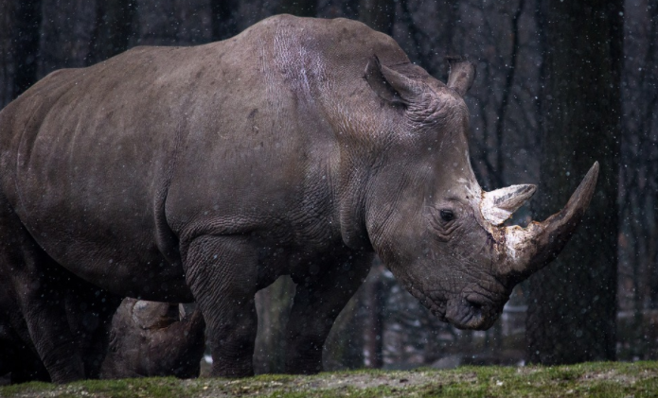
Or?
Notes:
We have looked at the many different feelings experienced when grief hits but grief can also show itself in behaviours that again can be very new and sometimes out of character.
People can be – Tearful Changes in appetite Running on overdrive lethargic Loosing focus Feeling physically sick and actually feeling ill
These can often be recognised as a part of grieving by others
and as humans we do need to work through these feelings and behaviours …we were created in such a way to have these reactions to trauma – and when we have them we aren’t meant to hide from them…they are a part of how we cope
And we need time to work through them …own those feelings, explore them and sort the chaos into order and learn from them.
So we need to give people time to do this.
As Christians we recognise that God will be in the pain helping the person gently work through the chaos.
.
So we need to be prepared to take notice of the people we meet and look out for signs of grief….and we need to accept the feelings and behaviour’s and be there with an open mind and an open heart!
And we can look at ways to create a safe environment in which people can do this.
The last thing we want is for a person to get stuck in the depth of their emotional turmoil and be able to move forward and through their grief.
It would be easy if we knew a quick fix for everyone but the fact is we are all different …God made us that way!
Look at the rhino and the hedgehog ……

Slide 6
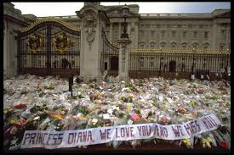
Different people grieve in different ways.
Notes:
This is a photo from princess Diana death… grief can affect different people grieve in different ways…
Who the person was who has been lost …father / mother / partner / friend
The nature of the attachment / much loved partner, parent, relative / a child or baby, or unborn baby / close friend / loved pet / respected colleague / a person who you found difficult to love…who perhaps caused you harm…all are a loss but each sparking different feelings
The way the death or loss occurred whether it was expected or a total shock…for example accidents / completed suicide / or the natural end to a long lived life / sudden redundancy or job loss / a change such as suddenly being asked to self isolate!
Sudden tragedy..manchester arena...need professional support…...
Could develop in to abnormal griefs, symptoms…
Minor event trigger intense grief, unwillingness to move deceased persons possessions, imitation deceased persons physical symptoms, excessive phobias, radical lifestyle change
Historical grief that suddenly raises it’s head, perhaps that has been hidden, suppressed / or a new loss on top of old hurts that can multiply the feelings you have….health warning..
Social status – stiff upper lip! and protecting the rest of family
Whether you have good support systems in place / or you are on your own
:
.
!

Slide 7
The Stages of Grief
Elisabeth Kubler-Ross
Notes:
We’ve just worked out together that there can be different feelings, different behaviours at different times, all together, or maybe none at all for some time and then later they all come out…
.and its important that grief is felt, have to go through , death midwifes… body does know what to do,
our greatest gift is to allow folks to walk through their journey accompanied..
We have a lot to thank Elizabeth Kubler-Ross who did a lot of work on grief back in the 1960s tried to but the feelings behaviours into a framework,,,that would be helpful, informative, not prescriptive, a heads up of possibilities but as we are all different no one shares exactly the same path, time or methods ..
Just going to take a quick look at her thoughts...so firstly
.

Slide 8
The Stages of Grief
Elisabeth Kubler-Ross
Denial
Notes:
Denial – paralysed with shock – is it a bad dream? This is When your mind can’t fully cope. It helps us survive the loss. Natures way of letting in only what we can cope with. You may find the person retelling the story of loss over and over again. This is an important thing that helps them make sense of what has happened and you often find someone retelling the story over and over again to whoever will listen!

Slide 9
The Stages of Grief
Elisabeth Kubler-Ross
Denial
Anger
Notes:
Anger the intense emotions – for lots of reasons…why didn’t I see this coming…who’s fault is it?...why couldn’t he be saved?...Why am I left behind?...This wasn’t supposed to happen. Anger and then other feelings flood in, sadness, panic, hurt, loneliness…all those emotions we have already talked about.
Anger is a necessary stage of the healing process… angry with God, friends, the man in the street, the world!
Underneath this anger is PAIN. The anger is just the indication of the intensity of their love. In a way anger opens the flood gates to all other emotions…so people who are grieving need to feel it…it’s normal!
.

Slide 10
The Stages of Grief
Elisabeth Kubler-Ross
Denial
Anger
Bargaining
Notes:
3. Bargaining - - get lost in a maze of…if only’s.
They want to go back in time.
Bargaining can fill the gaps that those strong emotions occupy…keeping those strong emotions at a distance.. what if, if only, why?
It’s the bodies way of Giving minds time to adjust to the reality and pain.. Helping restore order to the chaos and can actually bring the person to the point of acceptance of what has happened.
These stages can be visited over and over again…in different order too! Anger, denial and bargaining can become a grieving persons constant companion…

Slide 11
The Stages of Grief
Elisabeth Kubler-Ross
Denial
Anger
Bargaining
Depression
Notes:
4. Depression – after bargaining the mind will move into the present…the reality…bringing an emptiness that is deeper than they could ever have imagined!
Feels like it will last forever…withdraw from life…can’t see an end to the pain.
Life feels pointless, days don’t matter, why eat? Why get up even?
Important to know that this is normal…expected…part of the grieving process
.
Depression is often seen as something to be treated but in this case it is natural and a necessary step along the road of grief.
Treating grief depression is a balancing act …
the positives to this depression is…it slows us down, it makes us rebuild ourselves from the ground up, it takes us to a deeper place in our soul.
A grieving person should be allowed to experience his/her sorrow and our part is to sit with our friend as they do so!

Slide 12
The Stages of Grief
Elisabeth Kubler-Ross
Denial
Anger
Bargaining
Depression
Acceptance
Notes:
!
5. Acceptance – not hooray I am over it, lets get on with life now!
No it is the gradual acceptance of the reality and that a new normal is a reality…. They probably won’t like it as much as the old one but eventually it is accepted….they learn to live with it.
This is where their final healing and adjustment takes place. There is an acceptance that life goes on.
Here they begin to value the memories and take strength from them.
They learn to reorganize their lives, their role within it …to re-adjust to a new way of life. Here they stop using all their energy simply coping with loss and they start to invest it into coping with the new normal….a new way forward.
Don’t forget – these stages are not on a continuum…people will move in and out….up and down but the acceptance will begin to be the norm.
How do you resonate with these stages...could you share...was one harder for you than another, .

Slide 13
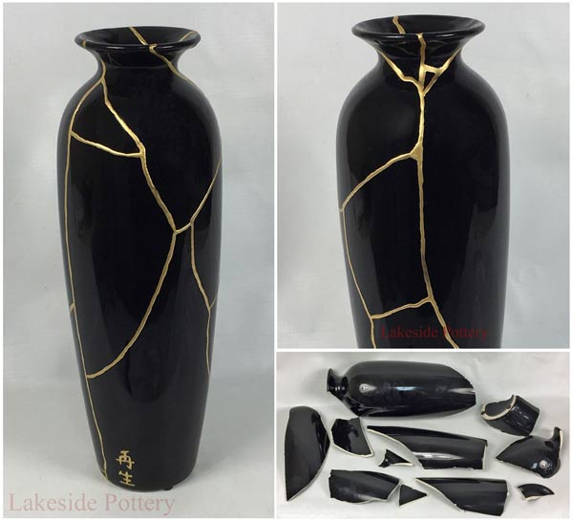
Notes:
Kintsugi is the Japanese art of putting broken pottery pieces back together with gold — built on the idea that in embracing flaws and imperfections, you can create an even stronger, more beautiful piece of art

Slide 14
Is this still relevant ?
Notes:
Is this relevant now…..well …...
Covid 19..
-There's denial, which we saw a lot of early on: This virus won't affect us.
- There's anger: You're making me stay home and taking away my activities.
-There's bargaining: Okay, if I social distance for two weeks everything will be better, right?
-There's sadness: I don't know when this will end. And finally there's acceptance. This is happening; I have to figure out how to proceed."
-Acceptance, as you might imagine, is where the power lies. We find control in acceptance. I can wash my hands. I can keep a safe distance. I can learn how to work virtually.”

Slide 15
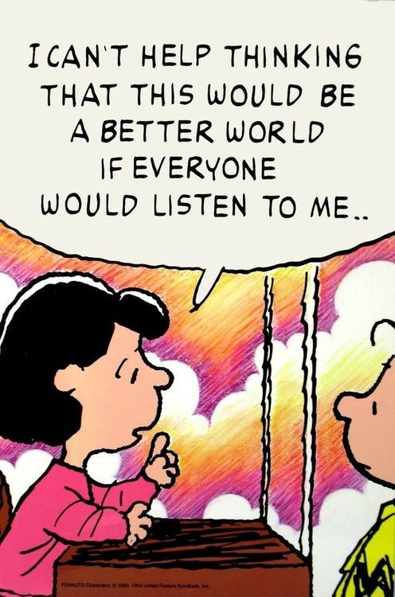
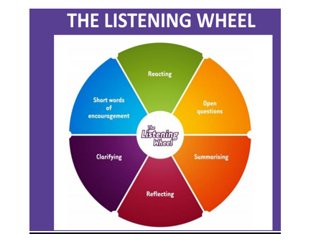
How to be a Good Listener
Notes:
So how can we respond when faced with a person suffering grief?
Compassion...its latin means to suffer with...be impacted by the grief the loss, it will affect us….
Firstly we need to be patient and expect to see that variety of responses and behaviours….
Listen with undivided attention … show they matter! (bearing their soul))
Remember and value what has been said including details
Watch for non verbal clues to help you understand what is happening
Tolerate pauses and silences and let them happen, don’t feel you have to break these silences
Extend some reassurance when needed …Be gentle, sincere, encouraging and confidential
Remain open minded and be non judgemental

Slide 16
What to say?
Notes:
Talking to the bereaved…We often worry about what we should say to people who are experiencing the pain of loss
Has anyone got any suggestions /ideas of what would be helpful to say??
Allow them to keep retelling the story of the death
Ask open questions that encourage a person to explore their feelings…”How did that make you feel?”
Don’t give glib answers to questions
Don’t try to defend God – He is big enough to defend Himself! But if it is appropriate be willing, as a Christian to reassure them of God’s love and care…God’s Hope amidst the sadness…if they want to offer to pray with them….it’s often appreciated. Listen to their angry or hurting outbursts and feel their pain along side them.
Don’t try to drag them away from their grief – It’s no good trying to cheer them up when they actually need to shout or cry! …they need to work through it
Reassure them that what they are going through is normal.

Slide 17
What not to say !!!!
Notes:
When we don’t know what to say we often say the wrong thing…we’ve all probably been in that situation
Here are some examples that perhaps we have each said or been like that hasn’t been helpful …but another health warning …don’t beat yourself up about it just think through this section and perhaps learn some lessons.
-dont pretend you haven’t seen someone/ too busy to talk.
--Don’t show intolerance….”oh no here we go again” attitude,
-dont show over-concern and make a drama out of it.
-Avoid saying things like …It’s part of Gods plan…you need to focus on the positive things, be thankful for what you have got! It’s time to get on with your life, they’re in a better place! -
But be careful not to give advice as if there’s a quick fix
Don’t forget we are all different and one persons way of coping can be very different to anothers
Dont say “I know what you are going through” – you don’t!
Don’t turn the discussion into them listening to you!

Slide 18
Notes:
Just thought I’d include this ...its Pablo Picasso's Guernica it was how he channelled his grief over nazi bombing of a small Spanish village in 1937
Picasso did what he could...want to try and encourage you...not to under estimate the value of offering some immediate support to those grieving where we are...as it says in Zechariah 4:10 .
Do not despise these small beginnings, for the Lord rejoices to see the work begin
So here are some ideas of things you could do:
If people have a faith they may gain amazing comfort from the church sit with them walk in with them pick them up go together but some find it’s a hard place to be and thats ok but keep talking about whats happening dont exclude them they are still part of the family!
Encourage people who are grieving to take care of themselves – loss can take all their energy and emotional reserves….they need someone to prop them up and help them to be kind to themselves
Could include Practical help like shopping, DIY, cooking, call round for a natter, suggest a walk, cinema.
Encourage them to keep up hobbies and interests its ok to have fun do things their loved one enjoyed...it can be a way of being with them
- be aware that certain things can trigger those intense feelings of grief such as anniversaries, Christmas, all sorts of milestones or places so be prepared to pre-empt the difficult times and be there for them.
Be in for the long haul…stay in touch…show you care.
Don’t make assumptions based on outward appearance…
The Pain of loss may never fully heal…give friendship, time and lots of love

Slide 19
You are not there to stop someone’s grief…
But you can help them wherever they are in their grieving process.
Notes:
Share any useful strategies,ideas, suggestions.
How to listen well – right environment -
what to say… what they found helpful
What have you done for others what have others done for you….

Slide 20
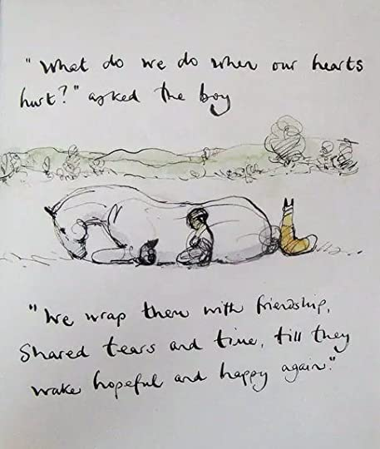
The boy, the mole,
the fox and the horse
Charlie Mackesy
.
Notes:
Queen Victoria was asked some time after her husbands death how she got over the sadness and grief….she said you never get over it….you just learn to live with it.
Our role is to Journey with them – wrap them in friendship…share their tears….and give them your time until they can stand steady again.

Slide 21
Do not hurry as you walk with grief; it does not help the journey.
Walk slowly, pausing often; do not hurry as you walk with grief.
Do not be disturbed by memories that come unbidden.
Swiftly forgive: and let Christ speak for you unspoken words.
Unfinished conversation will be resolved in Him.
Be not disturbed. Be gentle with the one who walks with grief.
If it is you, be gentle with yourself.
Swiftly forgive; walk slowly, pausing often.
Take time, be gentle as you walk with grief
A poem from Good Grief by Malcolm Duncan

Slide 22
Break for coffee!
Notes:
Come back to explore what resources are out there, opportunities for further training and we are going to hear from local leaders who have set up specific support groups. We also hope to give you time to think about your next steps and how we can be of help.

