Slide 1

Welcome Back!
Now Part 2...
Notes:
I don’t know if you saw this, the bbc interviewed the Archbishop of Canterbury and the Chief Rabbi, …WATCH….. Grief impacts you whoever you are…and reminds me of how important a safe place of support is…
so we will be looking more at ideas of how your church, workplace, your organisation might start something to actively support those who are grieving in your communities.

Slide 2
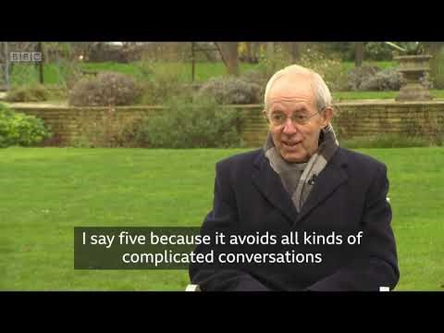
Notes:
I don’t know if you saw this, the bbc interviewed the Archbishop of Canterbury and the Chief Rabbi, …WATCH….. Grief impacts you whoever you are…and reminds me of how important a safe place of support is…
so we will be looking more at ideas of how your church, workplace, your organisation might start something to actively support those who are grieving in your communities.

Slide 3
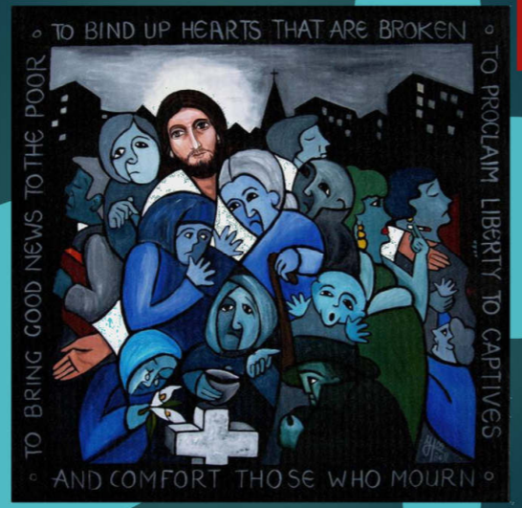
Notes:
I really like this painting, reminds we have a God who does care for the broken hearted, he wants us to comfort those who mourn…not to try and convert…but to walk alongside and help them remember those they have died with more love than pain and to live fully in the face of the loss

Slide 4
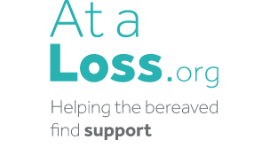
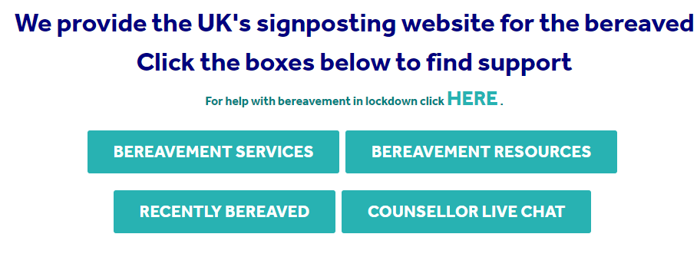
Notes:
Just want to highlight a couple of really great websites, that have a wealth of information and support both for those who are grieving and those providing support…, one stop place and has information which is area by area.
They have a live grief support chat monday-friday 9am -9pm and list other similar places offering this service.

Slide 5


The Good Grief Trust
https://www.thegoodgrieftrust.org
This is run by bereaved for the bereaved and aims to be a fully comprehensive online support website for both bereaved and those who support them.
A map of local support, videos and helpful advice, virtual pop up cafes to share stories.
Notes:
Very similar to ataloss main exception is that is run by people who have been bereaved for the bereaved ...and they organised National Grief Awareness week ..lots of information and resources…

Slide 6

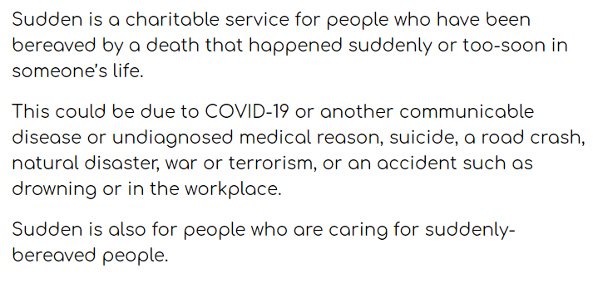
Sudden.org
Notes:
This is a very time specific charity …sudden unexpected death….particularly difficult, they and you might need extra support.

Slide 7
Issues to think about as you consider how to Respond to Grief and Loss in your Community
• Recognising grief
Notes:
So if you are thinking what can we do, where do we start…….I think you would agree particularly here in the west we do live in a death defying society….so
how could make death and dying less of a taboo subject?
Its a challenging issue but we all need to become better at talking about grief,..one way you could do this is by holding a death cafe.

Slide 8
Death Café ….online e.g.s?

Slide 9
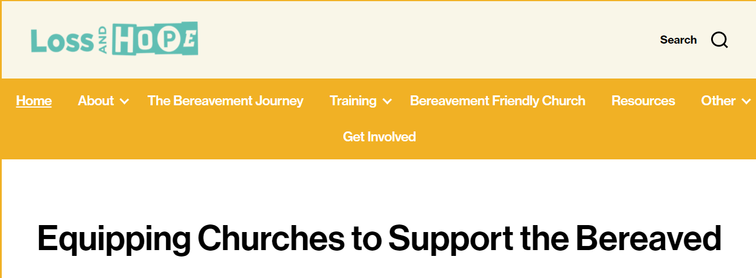
• Providing group support
Notes:
Another idea might be to start a Grief support Group,its so helpful for folks to know that they are not alone, not going mad, and just being able to others hare similar experiences and be in a place with others who understand can be so precious.
Loss and hope lot of good ideas, and they also have a lot of resources for supporting young people ..who often get overlooked as not children or adults…

Slide 10
Interview with someone already running a grief support group…what they do…
Notes:
..this is Pat From St Marys Eastwood
.how she runs a group,,,sits in a circle and go round and everyone say this is where I am this week, this is happening or that nor not, they can say exactly how they feel, what they want..and how they are coping at the moment….she shares about 2 other groups….8.31

Slide 11
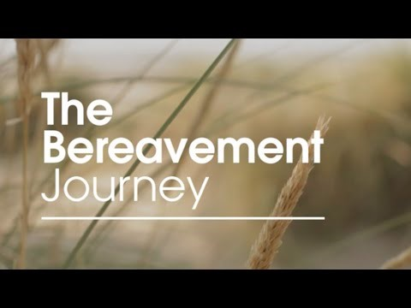
Notes:
This is a bit like Alpha, its a series of videos that you watch together and discuss, there is a leaders pack with help and advice
And is being done online and like alpha online working well , people in comfort of own home , removes travel and need to go and actively meet people….

Slide 12
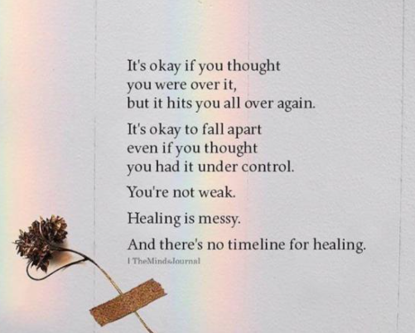
• Don’t over spiritualise grief
Notes:
As Christians we can often over spiritualise grief and fail to recognise the role that professional psychologists and counsellors play in helping individuals to process their grief…worth making sure you have list of people who can offer more support if needed.

Slide 13
Train Facilitators
Notes:
Continuing..….
While everyone can play their part in supporting those who are experiencing loss its important to have individuals who are trained to respond..just got a couple of suggestions….

Slide 14
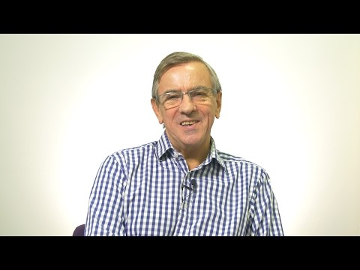

Slide 15
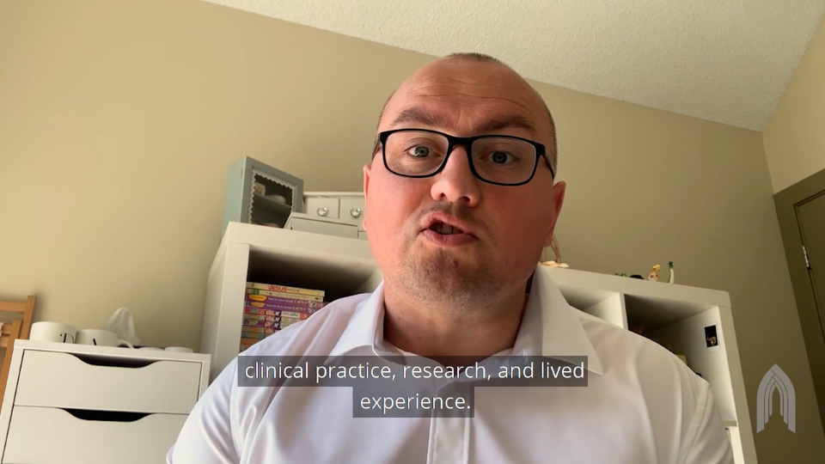
Faith, Grief, and COVID-19: A Conversation – Sanctuary Mental Health
https://www.sanctuarymentalhealth.org/uk/
https://vimeo.com/414817836/9cb92669ca
Notes:
This is a great resource for small groups looking at how as Christians we process grief , has good resources based on 4 different people talking about it from their experience….also have a lot of excellent mental health resources..

Slide 16
• Support for men
Notes:
Typically men don't reach our for bereavement support as readily as women so its worth developing initiatives that reach out specifically to engage men.

Slide 17
Example of group working just with men….men in sheds
Gardening group
Men and pies
Notes:
Talk about men in Sheds

Slide 18
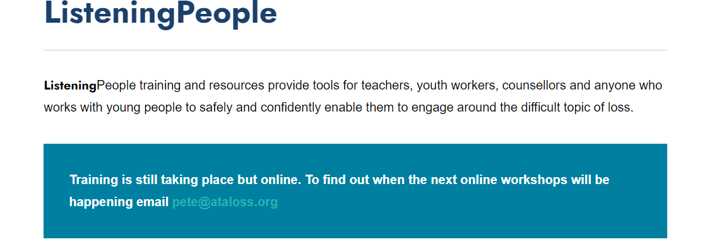

Support for young people
Notes:
Young people also process grief in a different way, children can often appear resilient but experiences make a lasting impact so its important they receive specific support

Slide 19
Questions?
Thoughts?
Concerns?
Notes:
Talk though ideas...can share grief support group workshops….

Slide 20
Great Resources
Notes:
Aware that we signposted the ataloss website but just wanted to encourage you with a small glimpse at the resources that are out there that will help you to support others and if you have experience of any and want to add that please do give us your suggestions

Slide 21



For Older folk
https://www.sueryder.org/online-bereavement-counselling

Slide 22




Mental Health

Slide 23
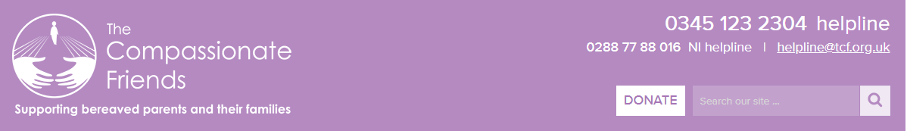



For children who are bereaved

Slide 24

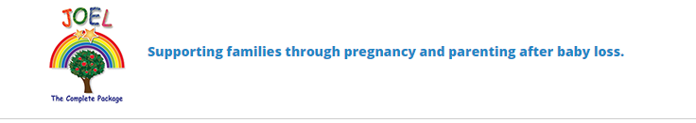
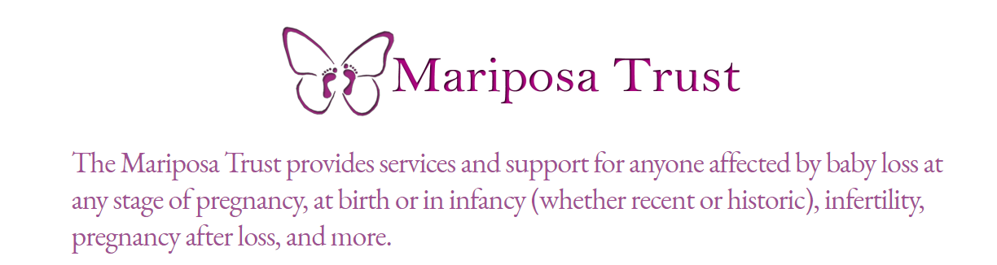
Death of a Child
https://www.joeltcp.org/
https://www.mariposatrust.org/

Slide 25



Sudden Traumatic Death

Slide 26

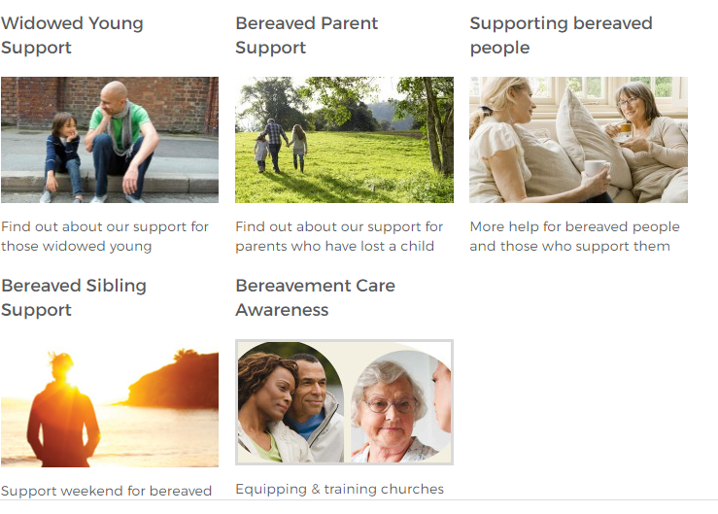
Widowed Young & Parents & Sibling

Slide 27
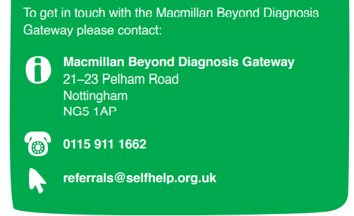
Cancer

Slide 28

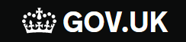

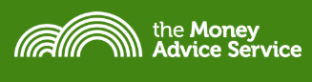
Practical support when someone dies
Notes:
In the notes are websites with ideas for questions to ask people before they die, how to introduce dying, what people want ,end of life issues….

Slide 29
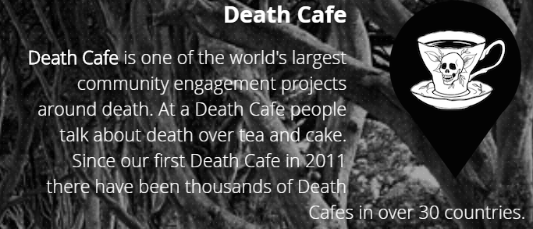


Practical support about Death and dying.

Slide 30
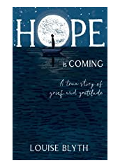
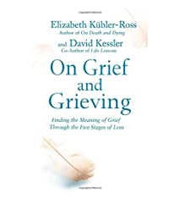

Notes:
Done quite a bit of reading...always more...please let me know your recommendations...

Slide 31
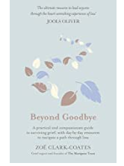
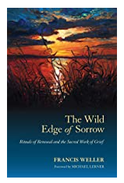
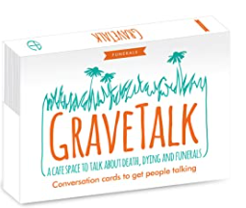

Slide 32
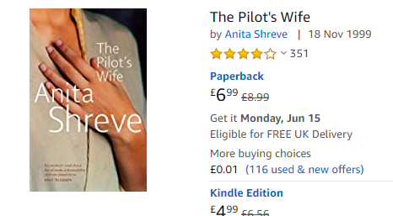

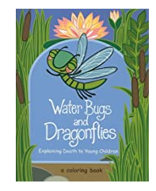

Slide 33




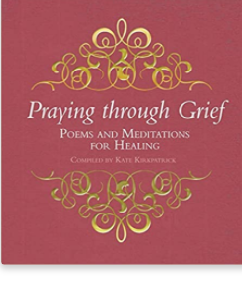

Slide 34
Radio and TV shows that
cover grief
Afterlife
Dead To Me
Good Grief - Jack Rooke (standup comedy)
Woman’s Hour
Word of Mouth by poet Michael Rosen
Grief Gang Podcast
Griefcast

Slide 35
Going forward... What next?
How can we help you?
Questions and Comments

Slide 36
Thank you
Notes:
Thankyou so much for attending/contributing and sharing in the discussions and giving examples and suggestions which we will add to the resources….will send you out a word document which hopefully if technology works will have all the correct hyperlinks so will take you directly to the websites..will also be sending out a survey..takes a few minutes would be so helpful if you would complete that its anonymous…!! any other comments please do get in touch

