Slide 1
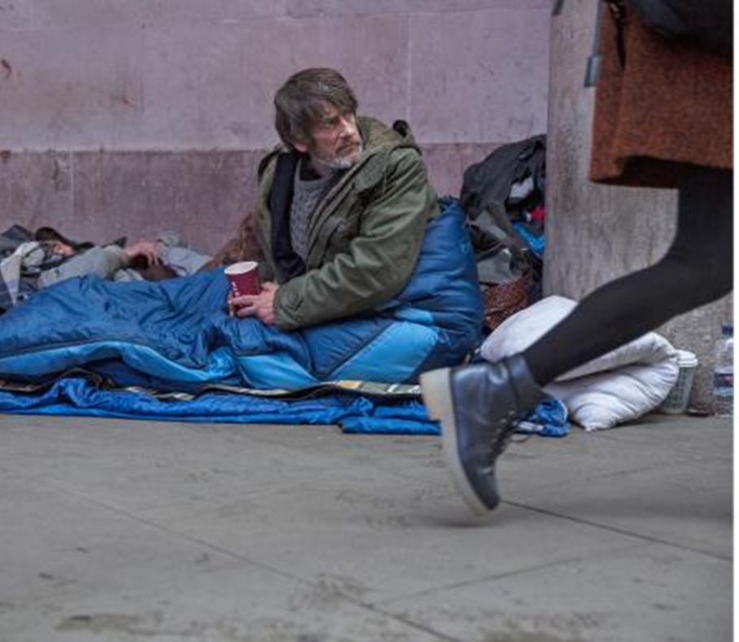
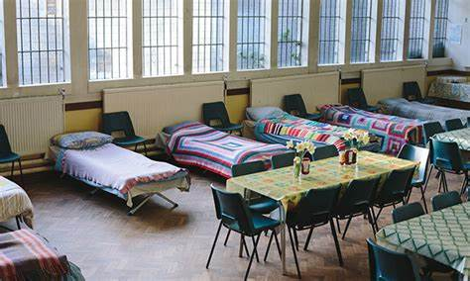
Restoring the Pathway to Affordable Housing
Challenges and Opportunities

Slide 2
Three challenges
Not enough affordable housing
It’s more than house-lessness
Superficial government policies

Slide 3
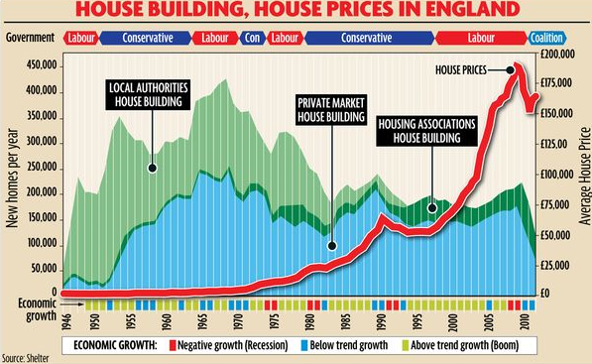

Slide 4
Poverty of resources
Poverty of relationships
Poverty of identity

Slide 5

Homeless iceberg
Rough sleepers in snapshot count
Rough sleepers not in snapshot count
Those begging, street drinking, using soup runs etc
Visibility level
Staying in emergency night shelters
Staying in hostels
Low personal resilience
Unaffordability of housing
Hotels & Temporary accommodation
Social isolation / loneliness
Squats and derelict properties
Sofa surfing
Benefit
problems
/ Universal
Credit
Insecure accommodation
Abuse & trauma
Staying with wider family & friends
Transient/vulnerable people within community
Zero hours contracts
Immigration
Family breakdown
Austerity and cuts
Mental health problems
Addictions
Underinvestment in housing

Slide 6
Three opportunities
Harnessing the power of faith
Creative and holistic responses
More unity & coherent pathway

Slide 7
Poverty of resources
Poverty of relationships
Justice & generosity
Mercy & compassion
Poverty of identity
Humility & faith

Slide 8

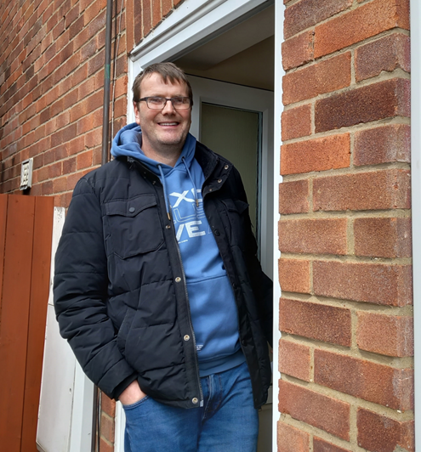
2) Creative and holistic responses
Every Church lovingly making a home for people who have been homeless
To mobilise, unite and unleash Christian prayer, investments, donations and relationships to fight the injustice of homelessness

Slide 9
New resources
New relationships
Quality house, refurbed, equipped, affordable rent
Friendship & Support, connection to church & community
New identity
Empowerment in recovery, work, serving, faith in community

Slide 10
Community & faith responses to homelessness
Night shelters: rotating model of 7 different venues, others fixed in one location
Support & advice: relating to addiction, health, debt, recovery groups & advocacy
Building-based: ‘soup kitchens’, lunches, clothes stores, emergency food provision
Supported Housing:
Local partnerships with churches / hosting schemes
Street based help:
soup runs, distributing food, sleeping bags, blankets, tents, informal outreach
Befriending & tenancy sustainment: employment support, social enterprise, participation in community
Intervention
Recovery
Prevention

Slide 11
No one comes off the streets (and stays off) due to the work of just one agency

Slide 12
Three challenges
Not enough affordable housing
It’s more than house-lessness
Superficial government policies
Three opportunities
Harnessing the power of faith
Creative and holistic responses
More unity & more coherent pathway

Slide 13


“He has shown you, O mortal, what is good. And what does the LORD require of you?
To act justly and to love mercy and to walk humbly with your God.”
Micah 6:8

