Slide 1
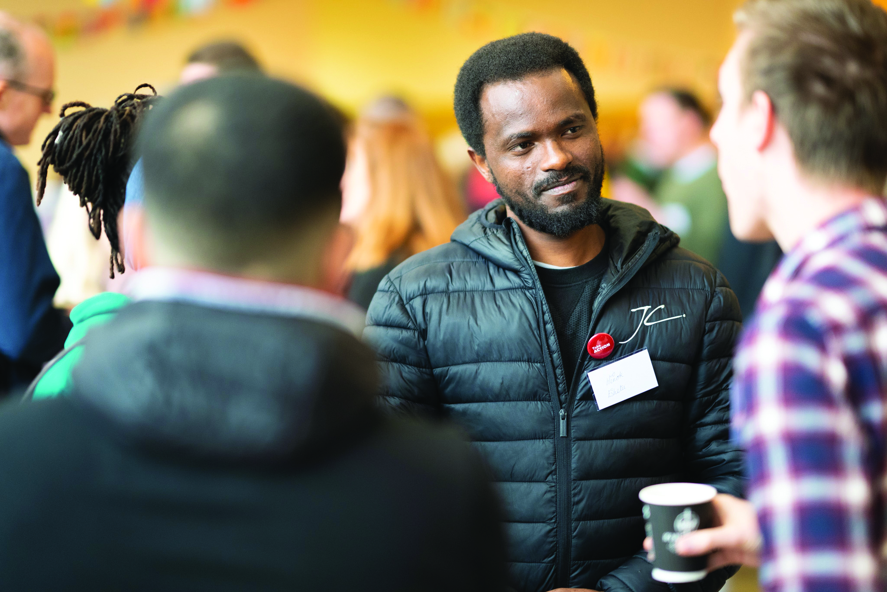
Homelessness & the Hope into Action model
Cathy Gretton
^{Hope} ^{into Action, Nottingham}
E: nottingham@hopeintoaction.org.uk T: 0115 8242196 W: hopeintoaction.org.uk

Slide 2
Homelessness: a complicated issue!
Contributing factors may be:
Political | Economic | Societal
Political decision-making and a lack of investment in affordable housing
Rising rents and wages not rising in proportion
Rising populations, longer life expectancy and fluid movement of people
Cutbacks in support systems and end of ‘Everyone In’ resulting in growing rough sleeper stats
Difficulty getting on to property ladder
Debt, mental health, addiction, war, abuse, crime, unemployment, trauma

Slide 3
Poverty of
resources
Poverty of
relationships
Poverty of
identity

Slide 4
‘Is not this the kind of fasting I have chosen: To loose the chains of injustice…to share your food with the hungry and provide the poor wanderer with shelter?’
Isaiah 58

Slide 5
The story so far...
We were set up in 2010 with our first home opened in Peterborough
Since then we have opened over 100 homes.
12 of those are in Nottingham
With over 100 church partners, including 8 in Nottingham
in 34 towns and cities
We currently have capacity for over 327 people to sleep in our homes every night
Last year, with our church partners, we housed 352 people!

Slide 7
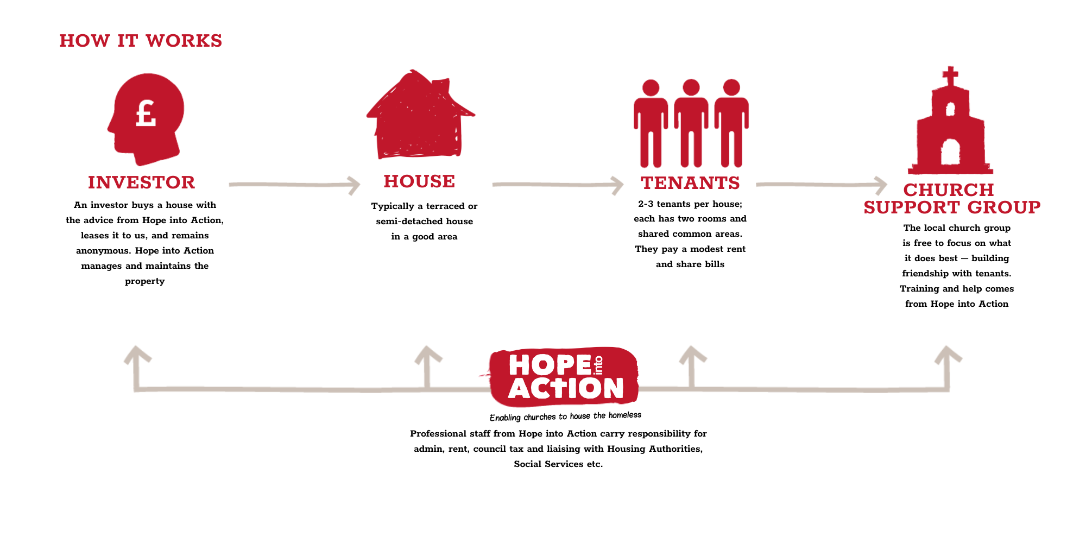

Slide 8
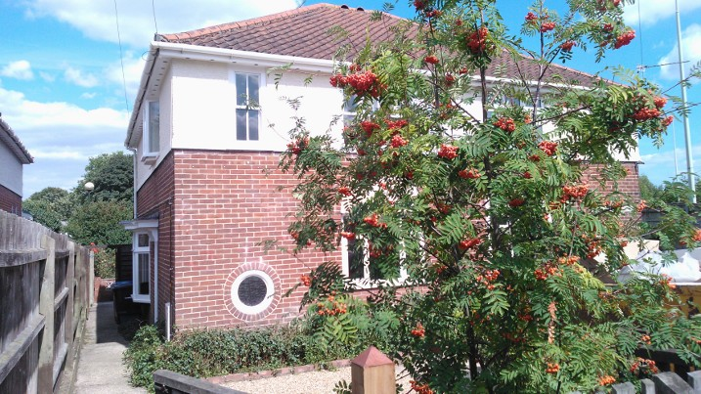
Investment grade
2-3 bedrooms
2% return
Not in a cul de sac
The right home
Terraced / semi detatched

Slide 9
The Partner Church
The Friendship & Support Group is made up of the following members:
Tenant befrienders
House & maintenance team
Prayer
F&S Coordinator (admin etc)
Church Champion

Slide 10
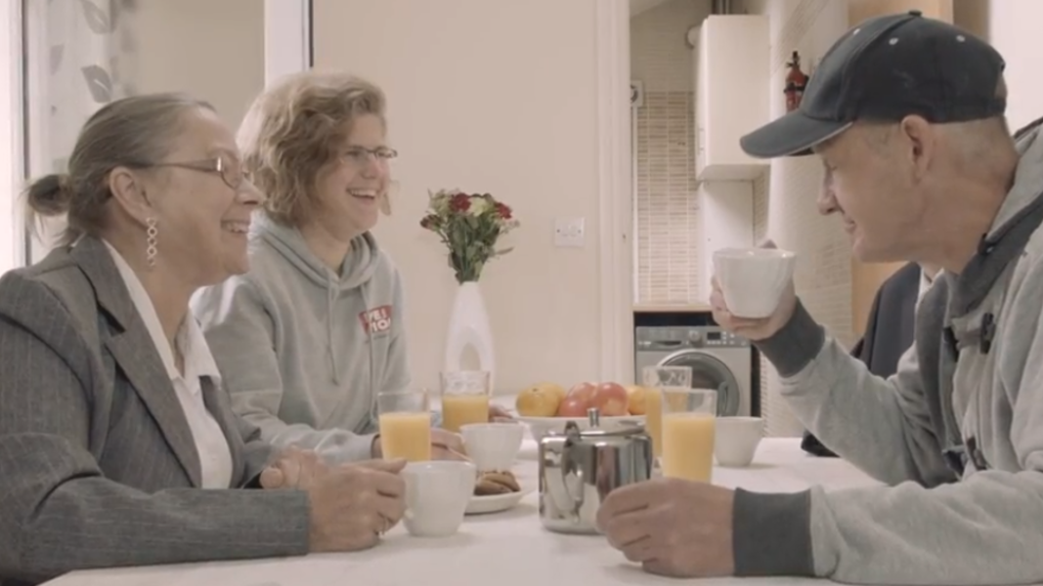
93%
Maintained tenancy or moved on well.
92%
Did not reoffend
88%
Improved social relationships
63%
Engaged with Faith
Notes:
22/23

Slide 11
New resources
New relationships
New identity

Slide 12
They didn’t just give me a ladder up, they helped me build my own staircase
I’m ready to move on. I’m anxious, but now I have the support of good people around me, I feel hopeful about my future for the first time ever

Slide 14
How can you be involved?
Notes:
So tonight we are goint to break into 2 groups now,
If you are interested in investing I have some more information and will be available to answer your questions around this
If you are interested in volunteer as part of the st marks friendship and support group then cathy is available for you to chat with about what this will look like and the next steps.
If you are another church that is possibly interested in how you could get involved than speak with sarah and

Slide 15
Any questions?

Slide 16
We would love to keep in touch Scan the QR code to sign up to our newsletters via our website. This way you can keep up to date with all the latest news at Hope into Action UK
^{Hope} into Action, 26 North Street, Peterborough PE1 2RA
E: info@hopeintoaction.org.uk T: 00 44 (0)1733 558301 W: hopeintoaction.org.uk

