Slide 1

Volunteer Responders
April 2024

Slide 2
Volunteer Responders
Digitally delivered volunteering platform enabling fast, real-time deployment
Adds capacity to local health and care services & improves delivery
Compliments existing schemes
An inclusive volunteering programme
Evolving programme developed using insights from local systems

Slide 3
Our journey so far
Adult Social Care Joins & Programme rebranded to NHS and Care Volunteer Responders
June
2023
Community Response & Pick-up and Deliver launch
Check In and Chat relaunched
March
2023
September
2022
Royal Voluntary Service & GoodSAM recomissioned to
provide the next phase of the programme
May
2022
Programme delivered as intended COVID-19 roles were suspended. NHS Transport and steward roles continued
January
2021
Expanded to provide Steward Volunteers
March
2020
Set up as COVID-19 response programme

Slide 4
Nearly 40,000 volunteers ready to support

Slide 5

Check In and Chat
Volunteers
Provide telephone support to people who would benefit from a friendly phone call
Provide companionship and encouragement to help improve mental health & wellbeing
Check In and Chat service is available for 18 weeks, with a different volunteer calling on each occasion.

Slide 6

Check In and Chat
Plus
Provide regular telephone support and some encouragement to help improve their mental health and wellbeing
Help people explore positive changes they can make to their lives
This support will be 3 calls a week, over a 6-week period from the same volunteer

Slide 7





Who might benefit
from the Check In and
Chat services
Individuals experiencing social isolation and loneliness Has a health condition
Has been recently discharged from hospital Is someone with caring responsibilities
Is waiting for elective surgery

Slide 8

Eligibility for support
Examples where the Check In and Chat service would not be appropriate:
Individuals with complex mental health problems
Individuals who are known to be suicidal
Individuals with severe cognitive impairment
Referrals for those with drug addiction
or alcohol dependency

Slide 9
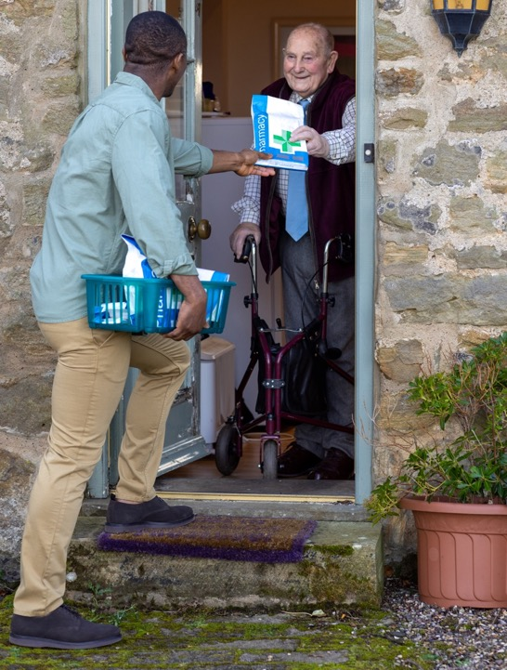
Community
Response Volunteers
Community Response volunteers support people in their local community with a range of activities including:
Food shopping Collecting essential items
Picking up prescriptions and medications
The volunteer support for this doorstep delivery service is available either as a one-off or once a week for a maximum of 6 weeks.

Slide 10

Who can request Community
Response Volunteers?
Healthcare professionals can refer people with a current health need for example, those waiting to be admitted to hospital or those who have just been discharged.
Adult social care professionals can refer people in receipt of care for example those that have a long-term health condition or live with ailments that prevent them from doing these activities themselves.
The support is also available to carers and to people with health conditions where there is a current health need.

Slide 11


Self-referral
The programme is also open for self referrals, which means that members of the public can refer themselves or someone that they know (with their permission) for Check In and Chat or Check In and Chat Plus calls, as well as Community Response support.
Self-referrals can be made by calling the Contact Centre on
0808 196 3646

Slide 12

Pick Up and
Deliver Volunteers
Volunteers can deliver small items of equipment to people at home or between sites. They can also assist with the transportation of medication from hospital to home.
TTO from acute settings
Virtual ward medicine and monitoring equipment
To support the timely discharge of patients
No biological specimens or controlled drugs
Referrals can be made for urgent short notice requests or scheduled future shifts

Slide 13




How to make
a referral

Slide 14
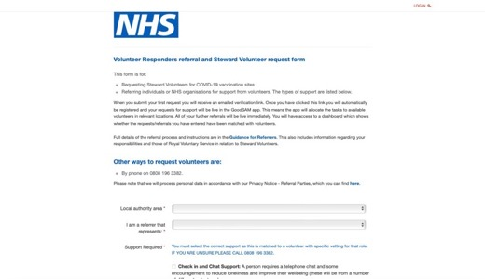
How to register and make a referral
www.nhscarevolunteerresponders.org.
19
Please note, this can take up to 72 hours. Please keep checking your inbox for a confirmation email from GoodSAM.

Slide 15
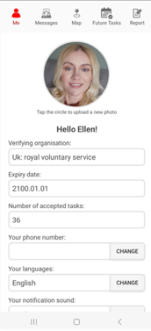
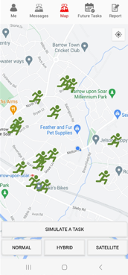
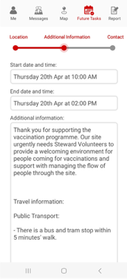
Volunteer task acceptance

Slide 16
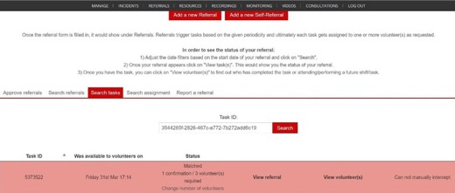
How to monitor your referrals

Slide 17

Safeguarding & Assurance
The safeguarding of people and volunteers is paramount.
Trained safeguarding team working 8am to 8pm, 7 days a week to pick up any concerns
Volunteers have an identification page within the app which they must show the people they are supporting
A process for removal or banning volunteers or people from the service for inappropriate conduct or behavior
A volunteer agreement which details expected behaviors of volunteers
A problem-solving team to help with volunteer concerns or issues
Patient/volunteer/referrer personal data is protected. Click here to find out more
ID and DBS checks appropriate to the activities being undertaken
23

Slide 18
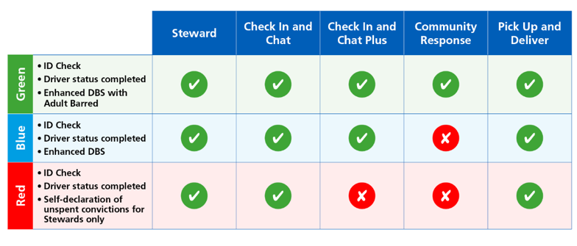
Safety & Assurance
ID checks are carried out for all volunteers, depending on what activity they undertake
This approach is in line with Home Office guidance around eligibility for DBS checks.
Click here for more information on safety and assurance

Slide 19
Support systems
Referrers
Website guidance
Problem Solving and Safeguarding teams
Ecomms
Potential webinars/focus groups
Dedicated RRMs
Marketing collateral
Volunteers
Website guidance
Official social media pages/groups
Problem Solving and Safeguarding teams
Ecomms
Potential volunteer webinars in the future
People we are supporting
Welcome letter
Website guidance
Problem Solving and Safeguarding teams

Slide 20

Our commitment to
equality and diversity
We Are Committed To:
Inclusion and Respect: We value inclusion and treat everyone with dignity and respect.
Community Inclusivity: We welcome referrals from all sections of communities and are committed to ensure the programme is open and accessible to all.
Safe and Inclusive Environment: Creating a safe and inclusive environment for volunteers and clients, regardless of age, disability, gender identity, race, religion or belief, sex or sexual orientation.
We do this through:
Collecting information and reporting on volunteer diversity to identify underrepresentation.
Ensuring programme is accessible for all communities (e.g. multilingual materials and language support).
Ensuring the programme and volunteers reflect the communities they serve.

Slide 21

Case Study | NHS
Jess Power, a Haematology Clinical Nurse Specialist at New Cross Hospital, utilises the NHS and Care Volunteer Responders programme to support outpatients.
“We have a cohort of, primarily older, house-bound patients who are unable to come to the Hospital to collect medications and do not have anyone to collect on their behalf. The Pick Up and Delivery service has been a game-changer for our patients. It ensures that they receive their essential medications promptly, and the feedback from our patients has been overwhelmingly positive. The volunteers have been extremely friendly and helpful.”
“I would definitely recommend the service to other health and care professionals.”

Slide 22
Case Study | Care
Samantha Aylott, Specialist Advisor for Adult Social Care at Essex County Council, regularly uses the Volunteer Responder programme
”It’s immensely helpful to be able to offer people emotional wellbeing support and the opportunity to have a friendly phone call as part of their care package. Having someone to chat to can mean a lot to the adults we work with; it’s about knowing someone cares and is interested in them.”
“I would recommend the programme to other social care providers, it’s quick and easy to use.”

Slide 23

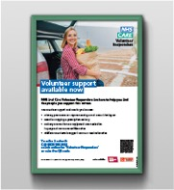
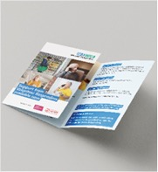
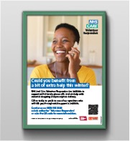
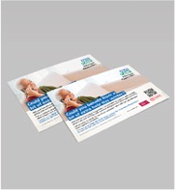

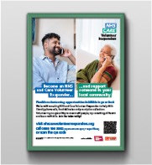

Marketing support
Referrer welcome pack
Self-referral Marketing materials
Volunteer Recruitment
Click here to request a referrer welcome pack

Slide 24
Key Contacts
Your Regional Relationship Manager is
Kerry Evans
Email: kerry.evans@royalvoluntaryservice.org.uk
Tel: 07884 114853
Contact centre telephone number: 0808 196 3382
Problem solving email: problemsolving@royalvoluntaryservice.org.uk
Website: nhscarevolunteerresponders.org
Royal Voluntary Service is a registered charity 1015988 (England and Wales) & SC038924 (Scotland).

